Slide 1
Using MC-ML
To run both mocat-mc and mocat-ml in one script, run combined_script.py
Before doing so, make edits to all paths in combined_script.py, mocat_mc_wrapper.m, and setup_MCconfig.m(Will be streamlined soon so this will be less tedious)
In the main function of combined_script.py, you must designate the path for the model you would like to run, the initial conditions for MC, and the size you would like to reshape to for the model (Ex. (1, 128, 32, 32))
All dependencies for both mocat-ml and mocat-mc are required
Windows is currently experiencing some issues do to posixpath and fastai so Linux is the best way to run it
Any edits to the variables for mocat_mc will be done like normal in the setup_MCconfig.m file

Slide 2
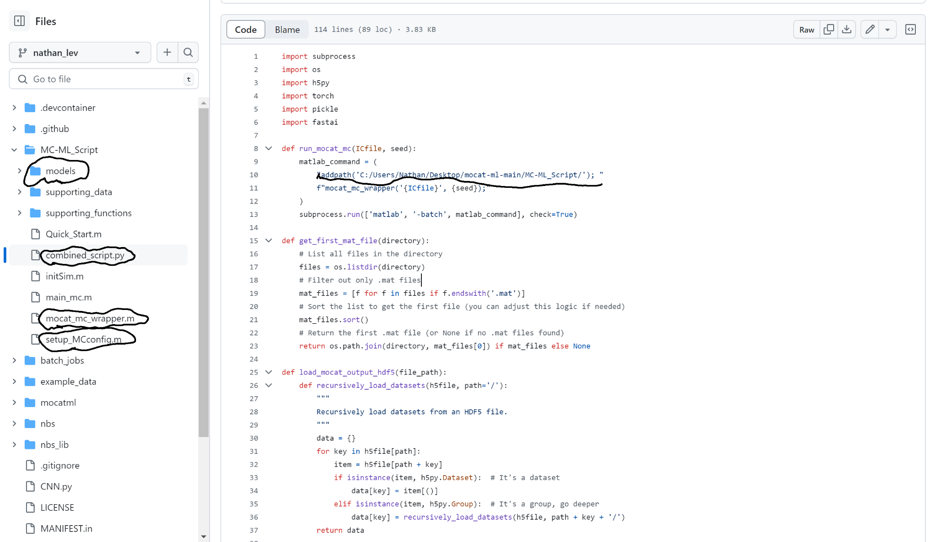
-Models: Stores trained models
-All circled files must have paths changed except for models
-Example of a path to be changed in image above

